Slide 1
Principal Component Analysis (PCA)
Lecture 39, 12-Nov-18
Dr. Partha Pratim Das
Department of Computer Science and Engineering of
Indian Institute of Technology, Kharagpur

Slide 2
Principal Component Analysis
Purpose
To reduce dimensionality of a vector image while maintaining information as much as possible
Known as:
Principal Component Analysis (PCA)
Karhunen-Loeve Transform (KLT)
Hotelling Transform
Eigenvector Transform
Nov 2018
‹#›

Slide 3
Principal Component Analysis
Image comprise n components:
3 components for RGB
6 spectral components in a multi-spectral satellite image
Collection of n “similar” images
For example, human faces
n Points in a region
Shape Analysis – get major axis
Find minimal number of components
Nov 2018
‹#›

Slide 4
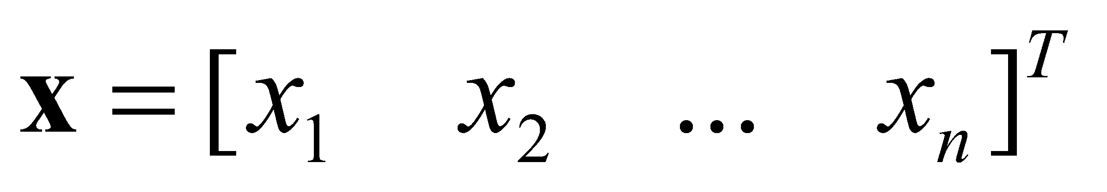
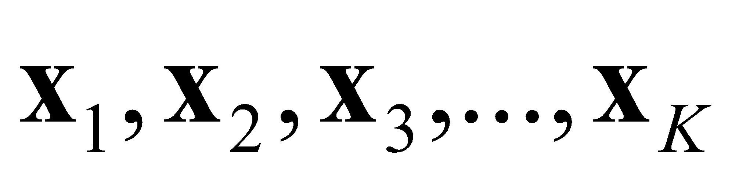
Principal Component Analysis
Each image pixel (point) can be represented as a n-D vector
If the image is of size MXN, we have K=MN n-D vectors
Nov 2018
‹#›

Slide 5

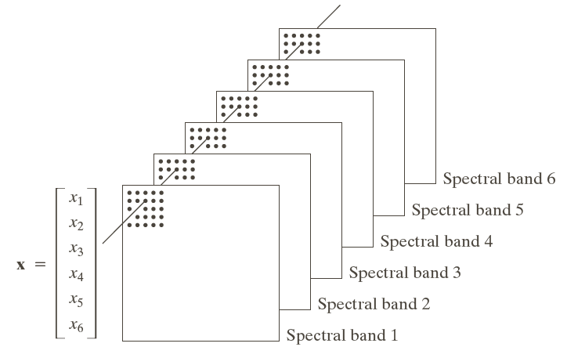
Principal Component Analysis
Nov 2018
‹#›

Slide 6
EIGENVALUES & EIGENVECTORS
Fundamentals
Nov 2018
‹#›

Slide 7
Eigenvalues & Eigenvectors
Definition: The eigenvalues of a real matrix M are the real numbers λ for which there is a nonzero vector e such that
Me = λ e.
The eigenvectors of M are the nonzero vectors e for which there is a real number λ such that Me = λ e.
If Me = λ e for e ≠ 0, then e is an eigenvector of M associated with eigenvalue λ, and vice versa. The eigenvectors and corresponding eigenvalues of M constitute the eigensystem of M.
Numerous theoretical and truly practical results in the application of matrices and vectors stem from this beautifully simple definition.
Nov 2018
‹#›

Slide 8
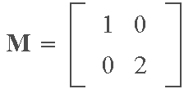
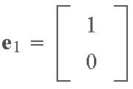
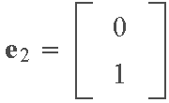
Eigenvalues & Eigenvectors
Example: Consider the matrix
and
In other words, e₁ is an eigenvector of M with associated
eigenvalue λ₁, and similarly for e₂ and λ₂.
Nov 2018
‹#›

Slide 9
Eigenvalues & Eigenvectors
A real matrix of order m×m
1. If {λ₁, λ₂,…, λ_{q}, q ≤ m, is set of distinct eigenvalues of M, and e_{i} is an eigenvector of M with corresponding eigenvalue λ_{i}, i = 1,2,…,q, then {e₁,e₂,…,e_{q}} is a linearly independent set of vectors. An important implication of this property: If an m×m matrix M has m distinct eigenvalues, its eigenvectors will constitute an orthogonal (orthonormal) set, which means that any m-dimensional vector can be expressed as a linear combination of the eigenvectors of M.
Nov 2018
‹#›

Slide 10
Eigenvalues & Eigenvectors
2. The numbers along the main diagonal of a diagonal matrix are equal to its eigenvalues. It is not difficult to show using the definition Me = λ e that the eigenvectors can be written by inspection when M is diagonal.
3. A real, symmetric m×m matrix M has a set of m linearly independent eigenvectors that may be chosen to form an orthonormal set. This property is of particular importance when dealing with covariance matrices which are real and symmetric.
Nov 2018
‹#›

Slide 11
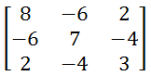
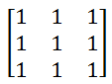
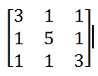
Eigenvalues & Eigenvectors
Problem: Find eigen values and eigen vectors for:
Problem: Find eigen values and eigen vectors for:
Problem: Find eigen values and eigen vectors for:
Nov 2018
‹#›

Slide 12
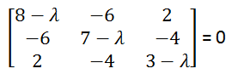
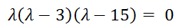
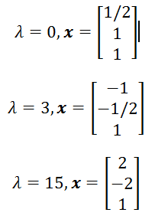
Eigenvalues & Eigenvectors
Solution:
Nov 2018
‹#›

Slide 13
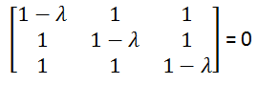
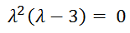
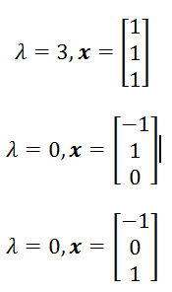
Eigenvalues & Eigenvectors
Solution:
Nov 2018
‹#›

Slide 14
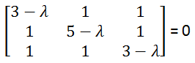
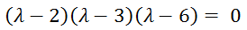
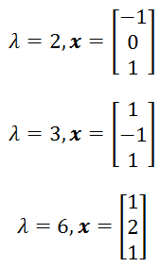
Eigenvalues & Eigenvectors
Solution:
Nov 2018
‹#›

Slide 15
PRINCIPAL COMPONENT ANALYSIS
Fundamentals
Nov 2018
‹#›

Slide 16
Eigenvalues & Eigenvectors
4. A corollary of Property 3 is that the eigenvalues of an m×m real symmetric matrix are real, and the associated eigenvectors may be chosen to form an orthonormal set of m vectors.
5. Suppose that M is a real, symmetric m×m matrix, and that we form a matrix A whose rows are the m orthonormal eigenvectors of M. Then, the product AA^{T}=I because the rows of A are orthonormal vectors. Thus, we see that A⁻¹= A^{T} when matrix A is formed in the manner just described.
6. Consider matrices M and A in 5. The product D = AMA⁻¹ = AMA^{T} is a diagonal matrix whose elements along the main diagonal are the eigenvalues of M. The eigenvectors of D are the same as the eigenvectors of M.
Nov 2018
‹#›

Slide 17

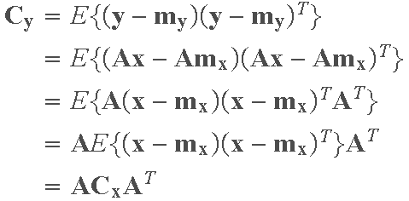
Eigenvalues & Eigenvectors
Example
Suppose that we have a random population of vectors, denoted by {x}, with covariance matrix:
Suppose that we perform a transformation of the form y = Ax on each vector x, where the rows of A are the orthonormal eigenvectors of C_{x}. The covariance matrix of the population {y} is
Nov 2018
‹#›

Slide 18
Eigenvalues & Eigenvectors
From Property 6, we know that C_{y}=AC_{x}A^{T} is a diagonal matrix with the eigenvalues of C_{x} along its main diagonal. The elements along the main diagonal of a covariance matrix are the variances of the components of the vectors in the population. The off diagonal elements are the covariances of the components of these vectors.
The fact that C_{y} is diagonal means that the elements of the vectors in the population {y} are uncorrelated (their covariances are 0). Thus, we see that application of the linear transformation y = Ax involving the eigenvectors of C_{x} decorrelates the data, and the elements of C_{y} along its main diagonal give the variances of the components of the y's along the eigenvectors. Basically, what has
Nov 2018
‹#›

Slide 19
Eigenvalues & Eigenvectors
been accomplished here is a coordinate transformation that aligns the data along the eigenvectors of the covariance matrix of the population.
The preceding concepts are illustrated in the following figure. Part (a) shows a data population {x} in two dimensions, along with the eigenvectors of C_{x} (the black dot is the mean). The result of performing the transformation y=A(x − m_{x}) on the x's is shown in Part (b) of the figure.
The fact that we subtracted the mean from the x's caused the y's to have zero mean, so the population is centered on the coordinate system of the transformed data. It is important to note that all we have done here is make the eigenvectors the
Nov 2018
‹#›

Slide 20
Eigenvalues & Eigenvectors
new coordinate system (y₁,y₂). Because the covariance matrix of the y's is diagonal, this in fact also decorrelated the data. The fact that the main data spread is along e₁ is due to the fact that the rows of the transformation matrix A were chosen according the order of the eigenvalues, with the first row being the eigenvector corresponding to the largest eigenvalue.
Nov 2018
‹#›

Slide 21
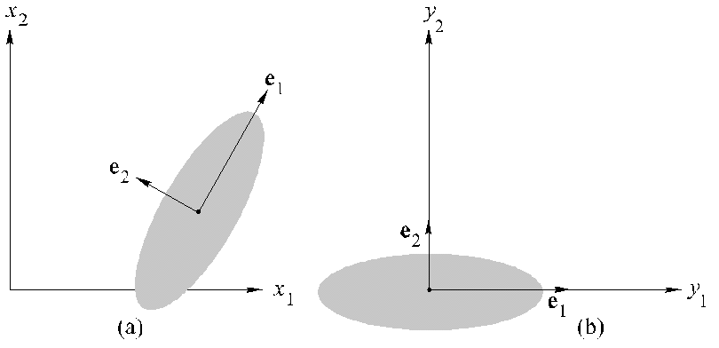
Eigenvalues & Eigenvectors
Nov 2018
‹#›

Slide 22

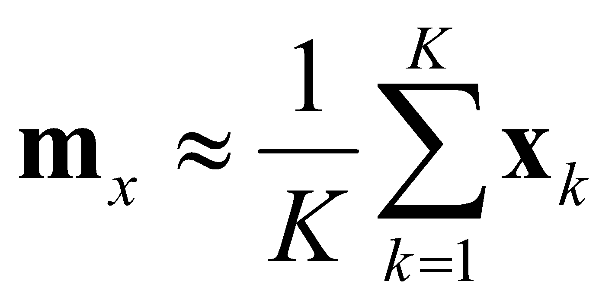
Principal Component Analysis
Mean of the population is given by:
Mean can be approximated from these vectors as:
Nov 2018
‹#›

Slide 23
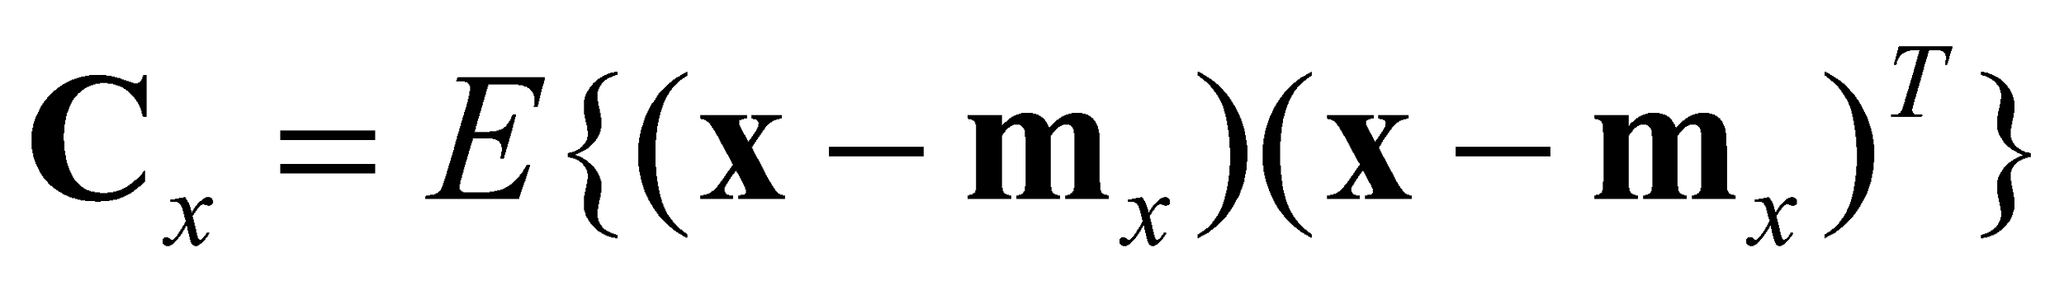
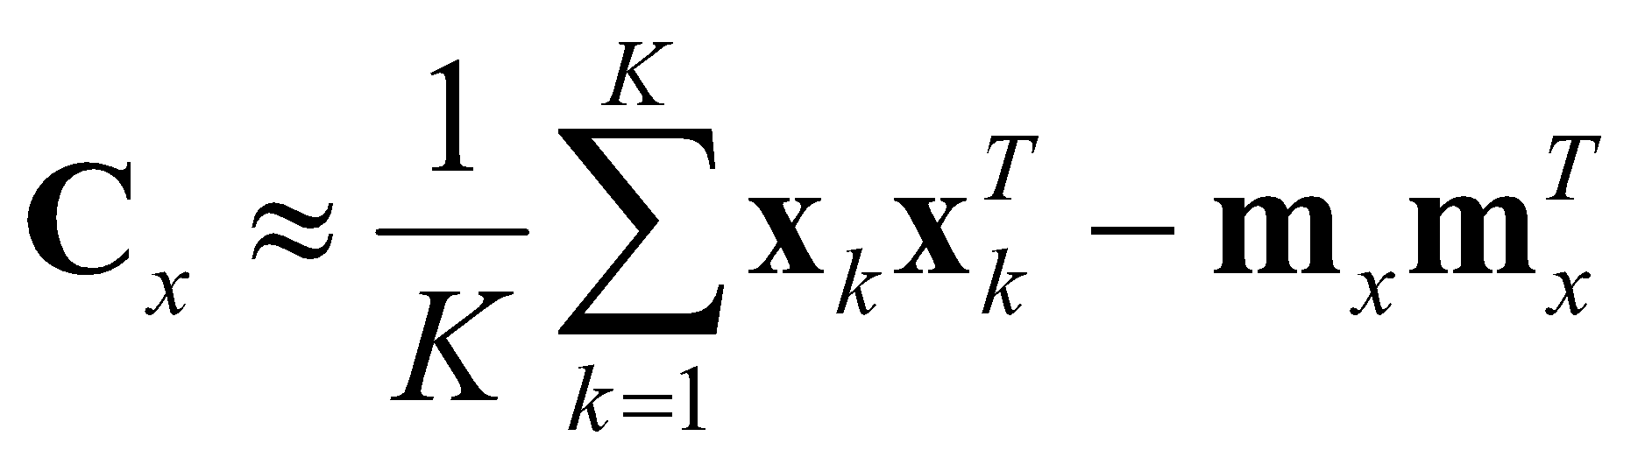
Principal Component Analysis
Covariance Matrix of the population is:
Covariance Matrix is approximated as:
Nov 2018
‹#›

Slide 24
Principal Component Analysis
C_{x} is real and symmetric
C_{x} is nXn
c_{ii} in C_{x} is the variance of x_{i}
c_{ij} in C_{x} is the covariance of x_{i} and x_{j}
If x_{i} and x_{j} are uncorrelated, the covariance is zero: c_{ij} = c_{ji} = 0
Nov 2018
‹#›

Slide 25
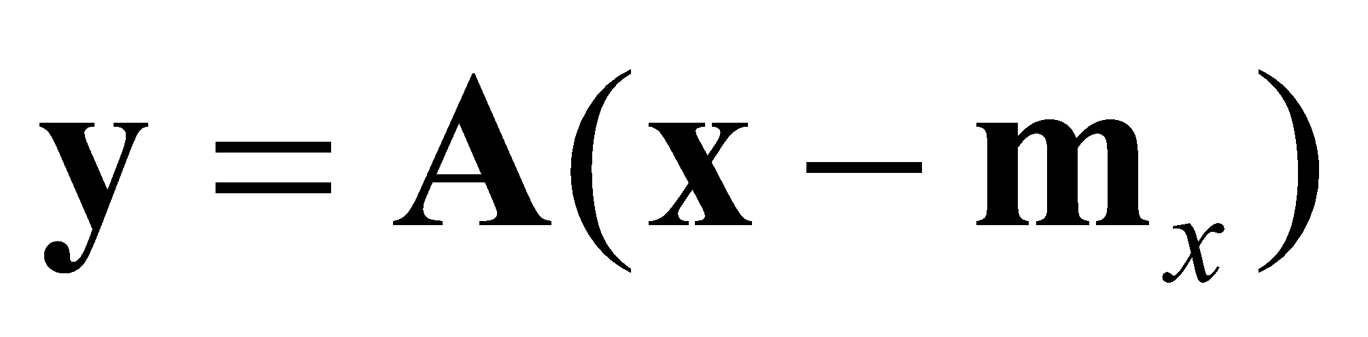
Principal Component Analysis
Let:
A is the matrix of eigenvectors of C_{x} as:
Row 1 of A contain the 1st eigenvector with the largest eigenvalue 𝜆₁.
Row 2 of A contain the 2nd eigenvector with the 2nd largest eigenvalue 𝜆₂.
…
Nov 2018
‹#›

Slide 26
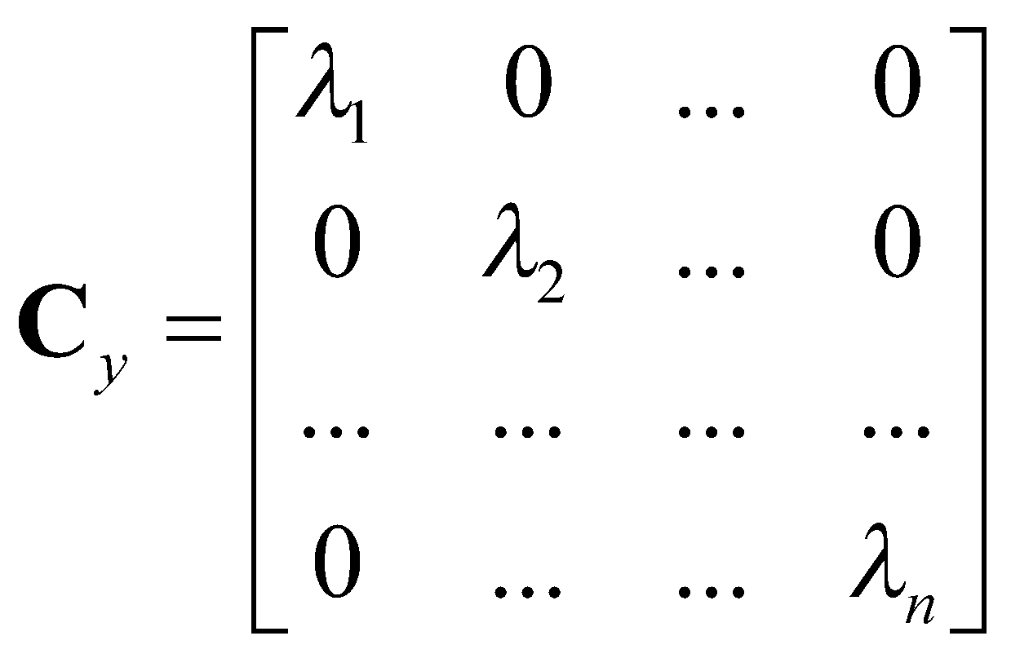
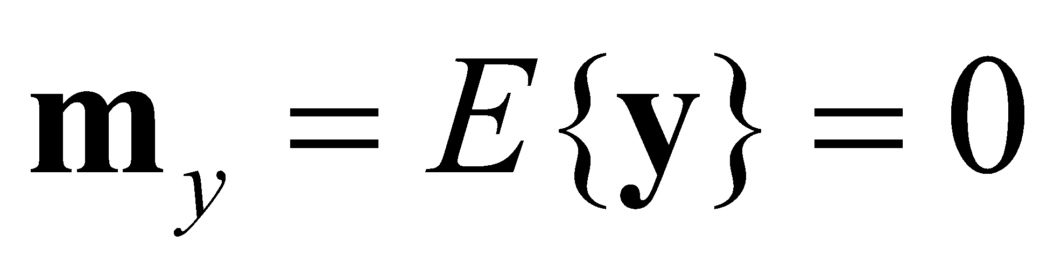
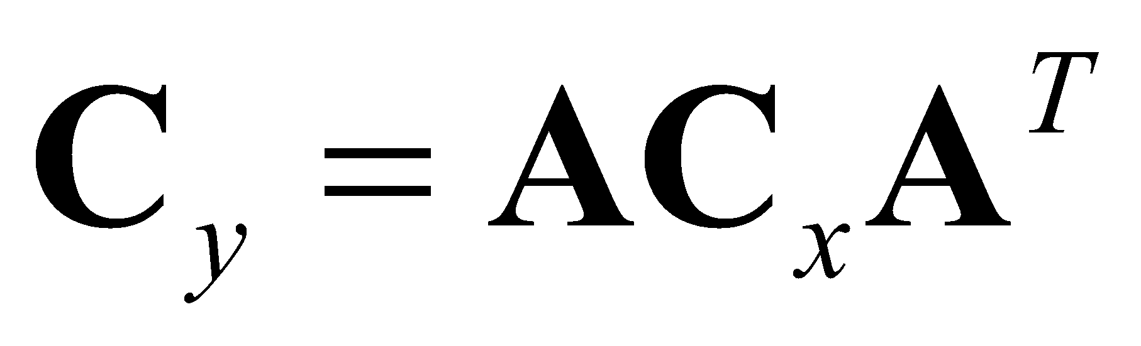
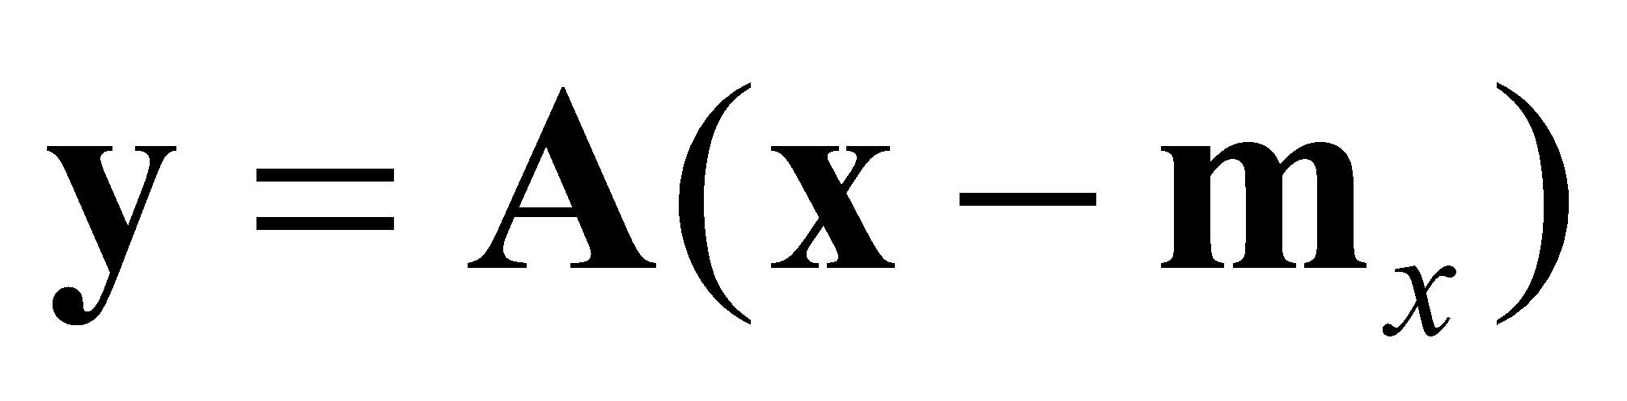
Principal Component Analysis
We get:
Elements of are uncorrelated.
The component of y with the largest λ is called the principal component.
Nov 2018
‹#›

Slide 27
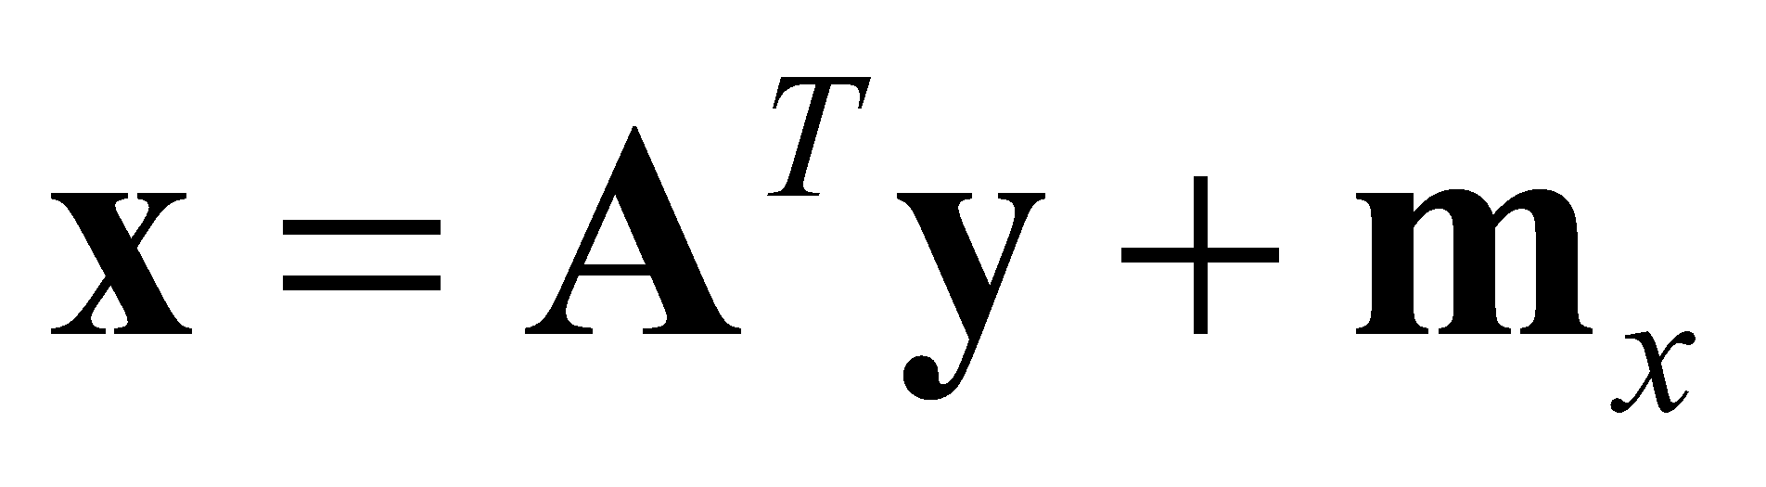
Principal Component Analysis
To reconstruct, we note:
Rows of A are orthogonal vectors
A⁻¹=A^{T}
Hence, we get:
Nov 2018
‹#›

Slide 28
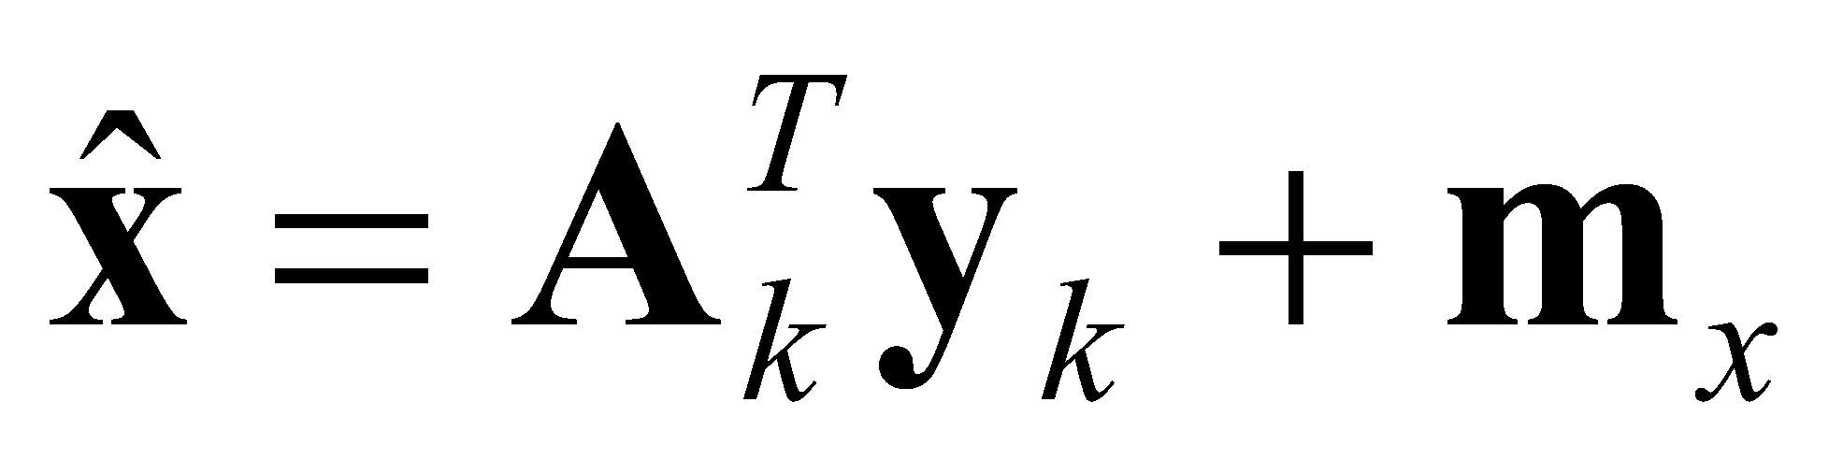
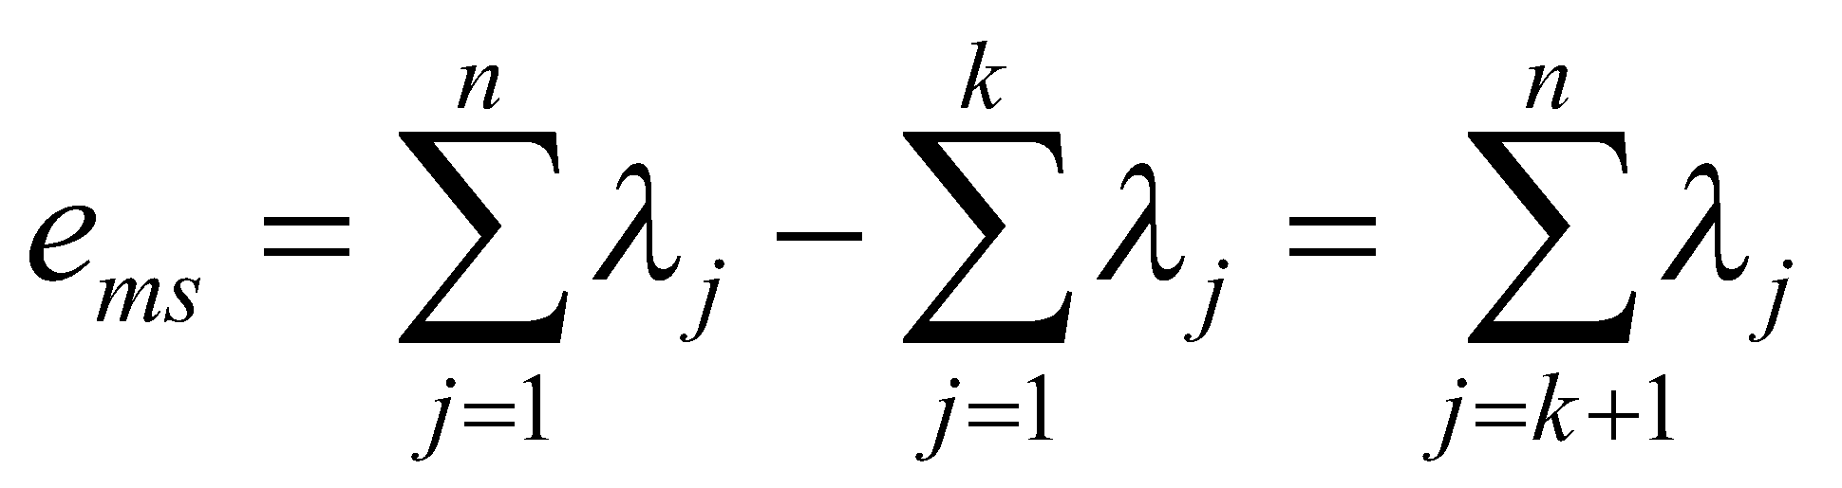
Principal Component Analysis
To approximate, we use a transformation matrix A_{k} (of order kXn) comprising k eigenvectors corresponding to k largest eigenvalues. y_{k} with k largest (first) components taken
This gives MSE as:
Nov 2018
‹#›

Slide 29
PRINCIPAL COMPONENT ANALYSIS
Numerical Example
Nov 2018
‹#›

Slide 30
PCA Example –STEP 1
Subtract the mean
from each of the data dimensions. All the x values have x subtracted and y values have y subtracted from them. This produces a data set whose mean is zero.
Subtracting the mean makes variance and covariance calculation easier by simplifying their equations. The variance and co-variance values are not affected by the mean value.
http://www.iro.umontreal.ca/~pift6080/H09/documents/papers/pca_tutorial.pdf
Nov 2018
‹#›

Slide 31
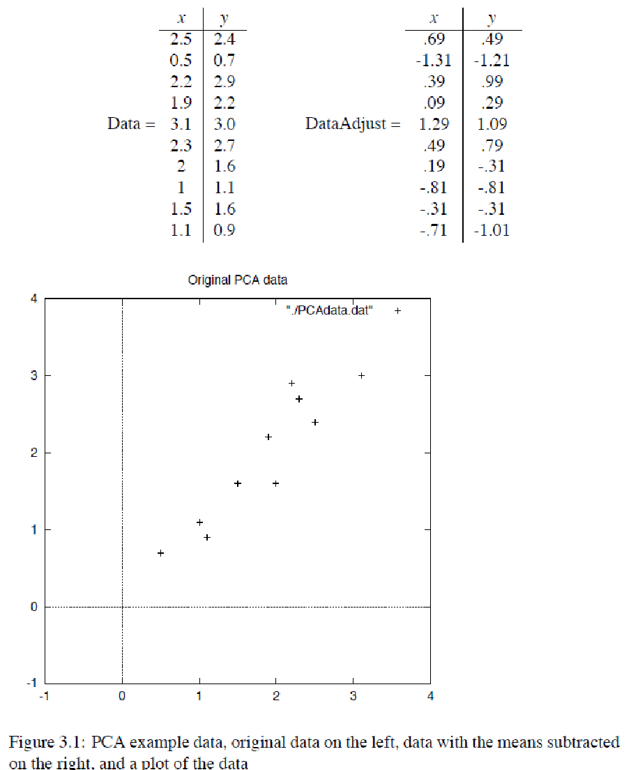
PCA Example –STEP 1
Nov 2018
‹#›

Slide 32
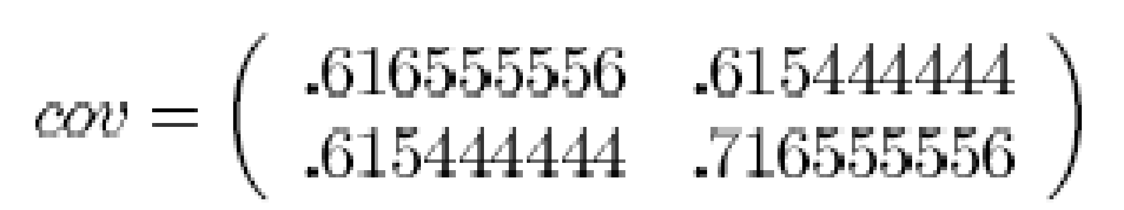
PCA Example –STEP 2
Calculate the covariance matrix
since the non-diagonal elements in this covariance matrix are positive, we should expect that both the x and y variable increase together.
http://www.iro.umontreal.ca/~pift6080/H09/documents/papers/pca_tutorial.pdf
Nov 2018
‹#›

Slide 33
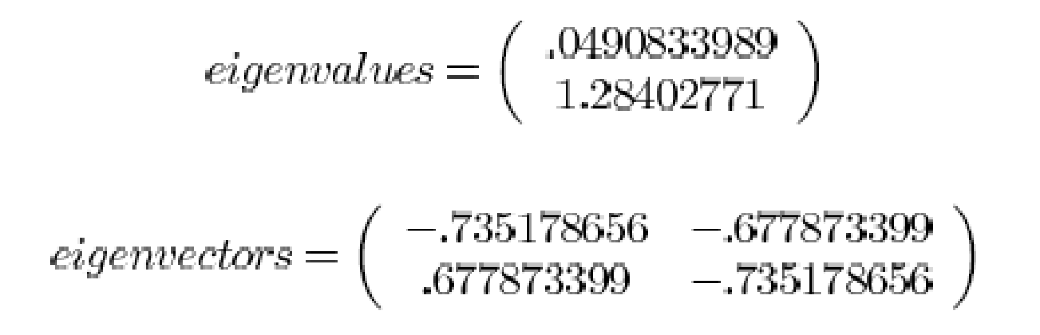
PCA Example –STEP 3
Calculate the eigenvectors and eigenvalues of the covariance matrix
http://www.iro.umontreal.ca/~pift6080/H09/documents/papers/pca_tutorial.pdf
Nov 2018
‹#›

Slide 34
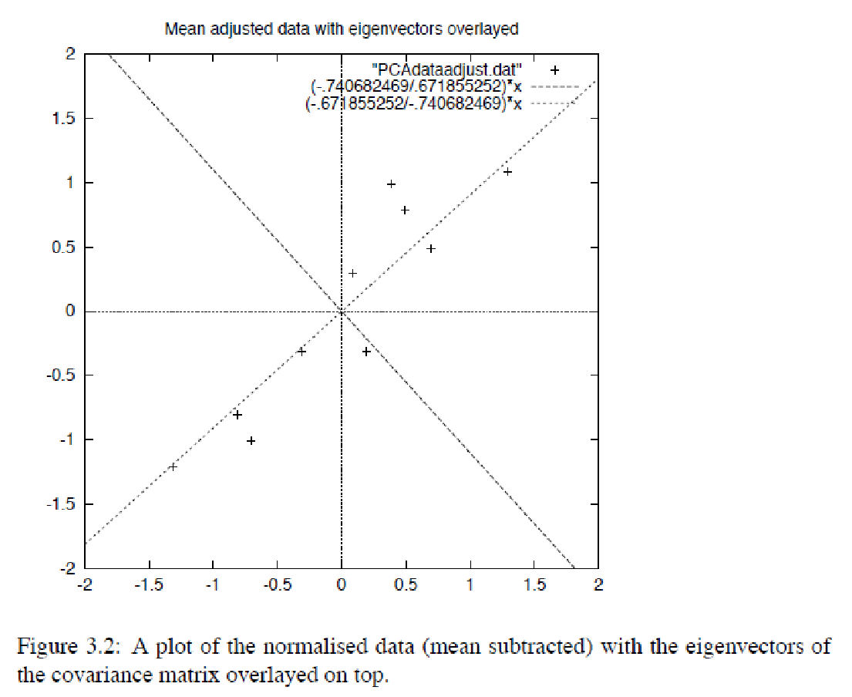
PCA Example –STEP 3
eigenvectors are plotted as diagonal dotted lines on the plot.
Note they are perpendicular to each other.
Note one of the eigenvectors goes through the middle of the points, like drawing a line of best fit.
The second eigenvector gives us the other, less important, pattern in the data, that all the points follow the main line, but are off to the side of the main line by some amount.
http://www.iro.umontreal.ca/~pift6080/H09/documents/papers/pca_tutorial.pdf
Nov 2018
‹#›

Slide 35
PCA Example –STEP 4
Reduce dimensionality and form feature vector
the eigenvector with the highest eigenvalue is the principle component of the data set.
In our example, the eigenvector with the largest eigenvalue was the one that pointed down the middle of the data.
Once eigenvectors are found from the covariance matrix, the next step is to order them by eigenvalue, highest to lowest. This gives you the components in order of significance.
Nov 2018
‹#›

Slide 36
PCA Example –STEP 4
Now, if you like, you can decide to ignore the components of lesser significance.
You do lose some information, but if the eigenvalues are small, you don’t lose much
n dimensions in your data
calculate n eigenvectors and eigenvalues
choose only the first p eigenvectors
final data set has only p dimensions.
Nov 2018
‹#›

Slide 37
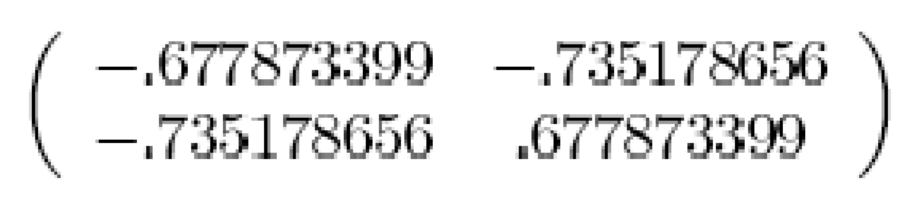
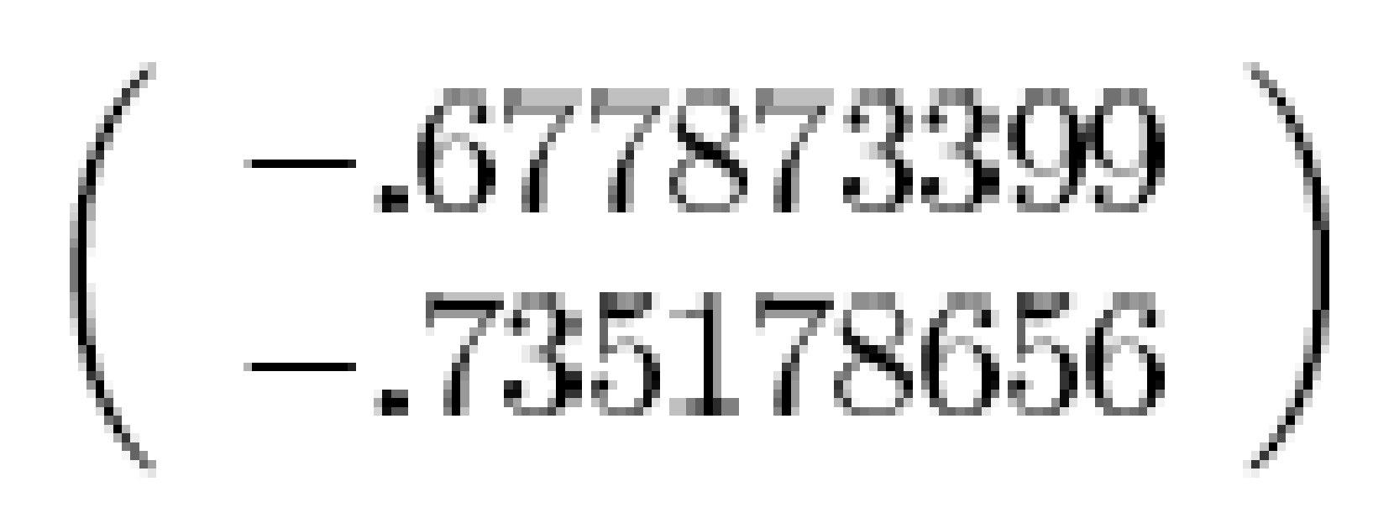
PCA Example –STEP 4
Feature Vector
FeatureVector = (eig₁ eig₂ eig₃ … eig_{n})
We can either form a feature vector with both of the eigenvectors:
or, we can choose to leave out the smaller, less significant component and only have a single column:
Nov 2018
‹#›

Slide 38
PCA Example –STEP 5
Deriving the new data
FinalData = RowFeatureVector x RowZeroMeanData
RowFeatureVector is the matrix with the eigenvectors in the columns transposed so that the eigenvectors are now in the rows, with the most significant eigenvector at the top
RowZeroMeanData is the mean-adjusted data transposed, ie. the data items are in each column, with each row holding a separate dimension.
Nov 2018
‹#›

Slide 39
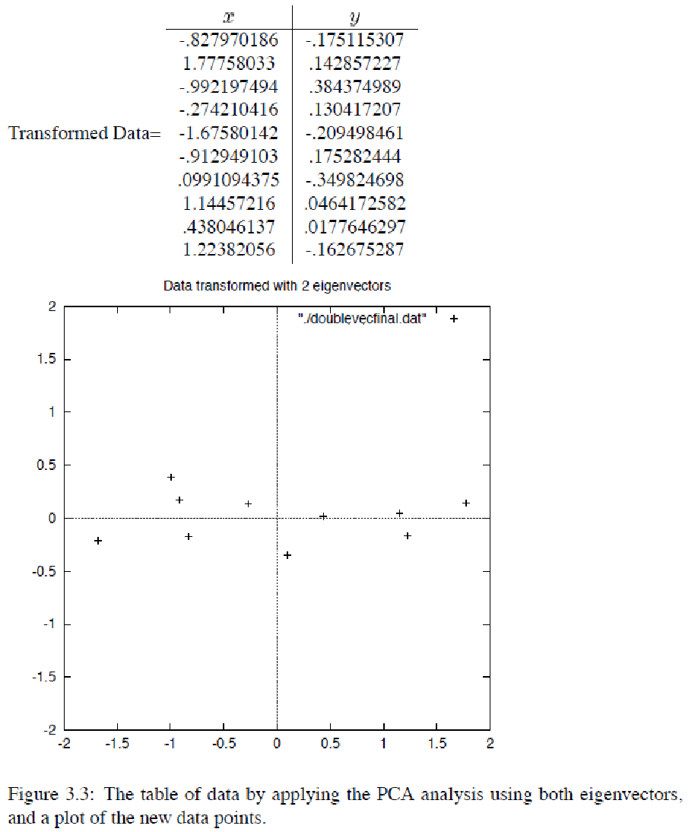
PCA Example – STEP 5
Nov 2018
‹#›

Slide 40
Reconstruction of original Data
If we reduced the dimensionality, obviously, when reconstructing the data we would lose those dimensions we chose to discard. In our example let us assume that we considered only the x dimension…
Nov 2018
‹#›

Slide 41
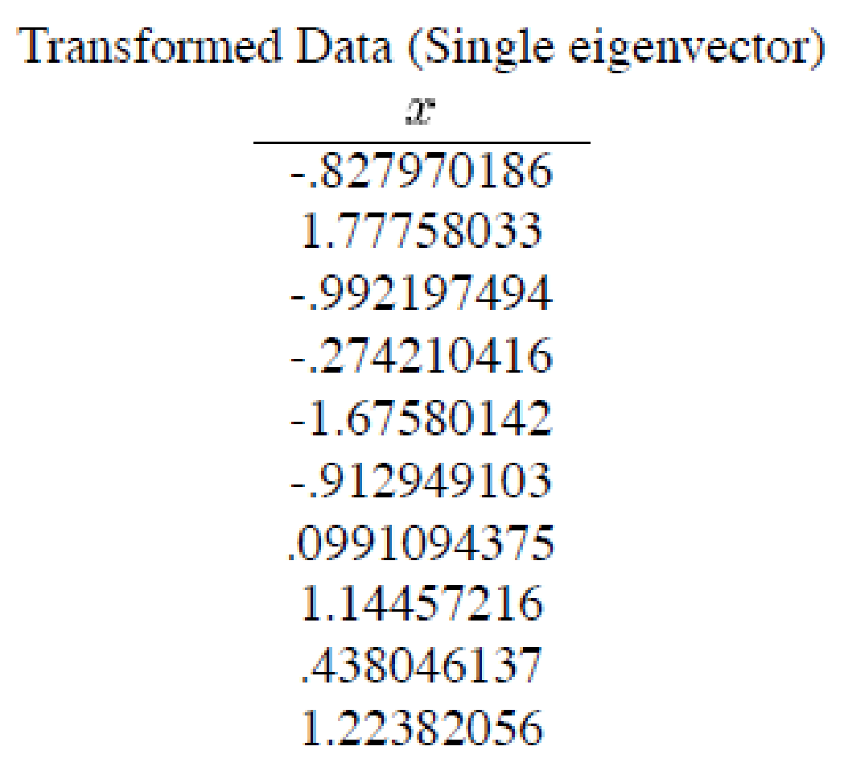
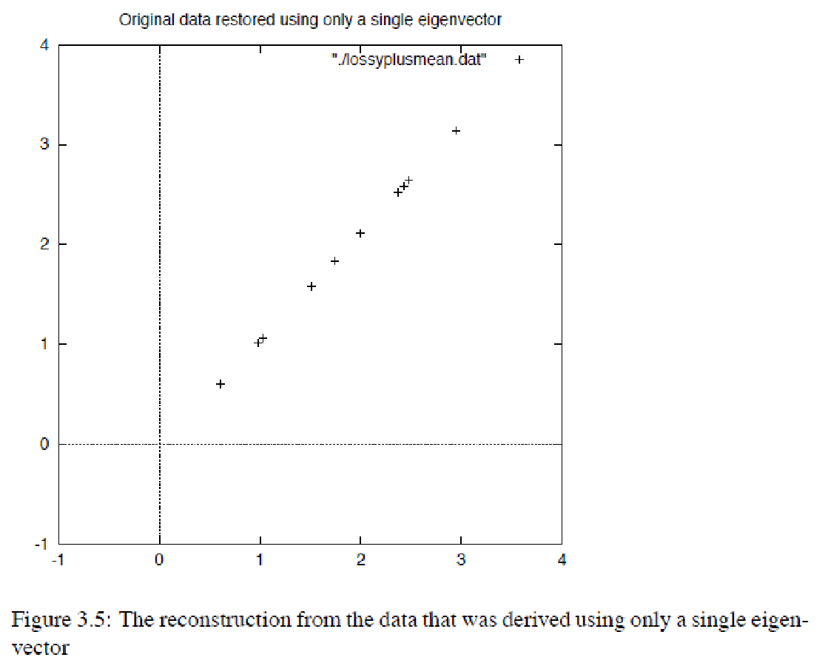
Reconstruction of original Data
Nov 2018
‹#›

Slide 42
PRINCIPAL COMPONENT ANALYSIS
IP Examples
Nov 2018
‹#›

Slide 43
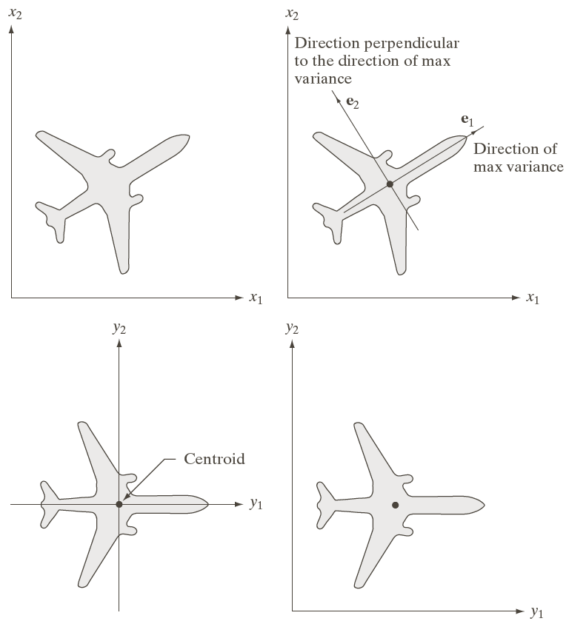
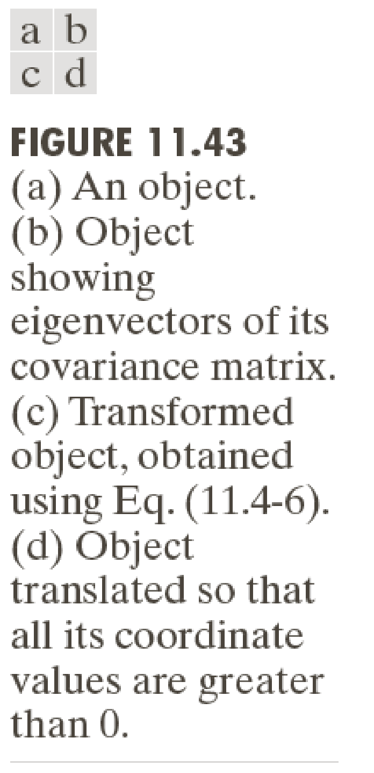
PCA: #1
Nov 2018
‹#›

Slide 44
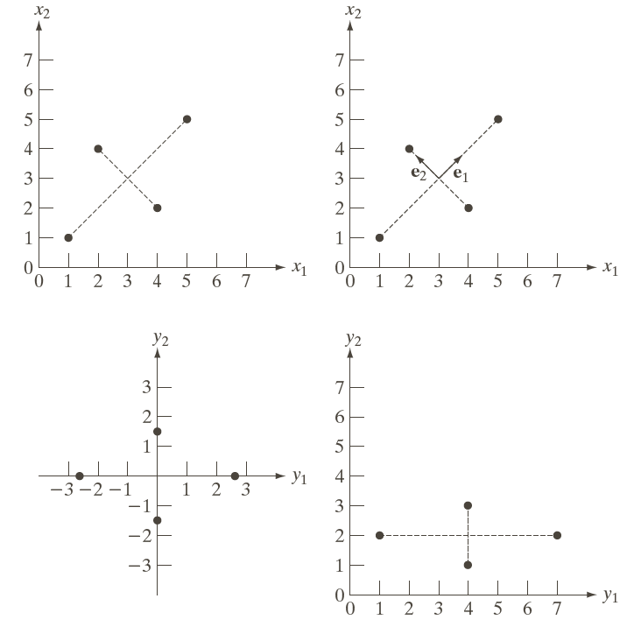
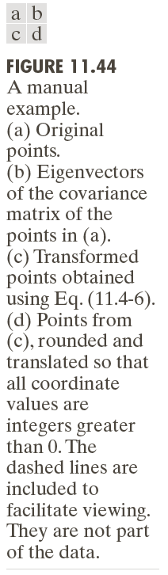
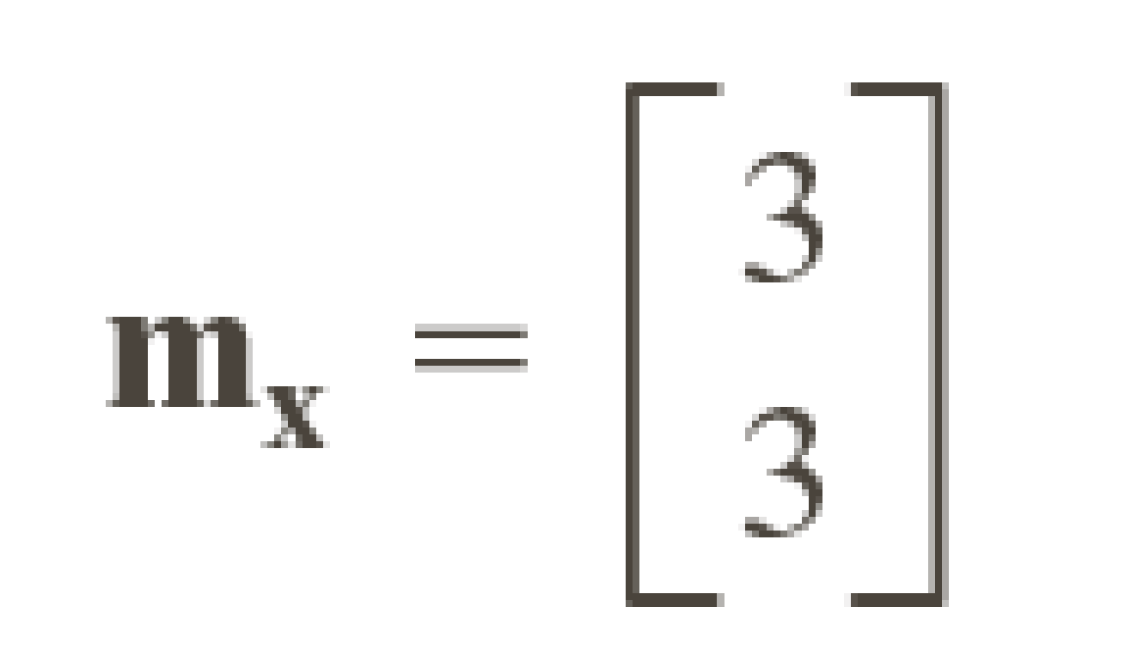
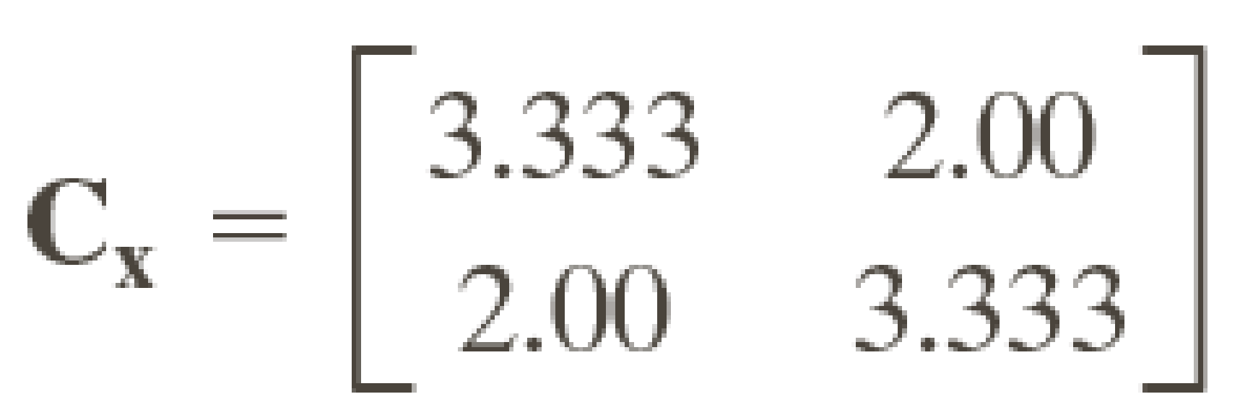
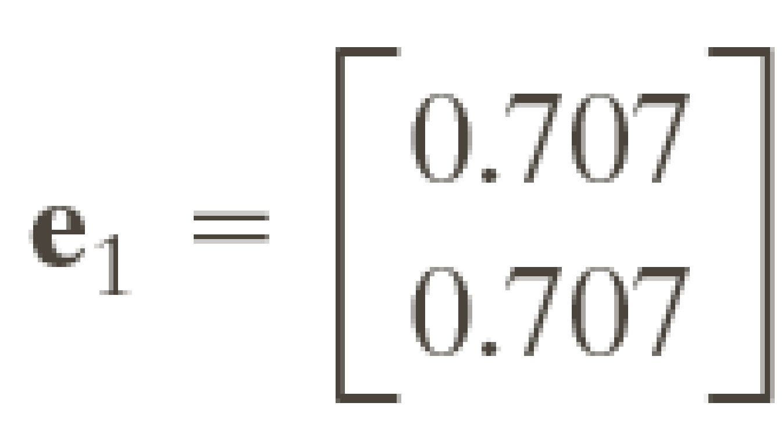
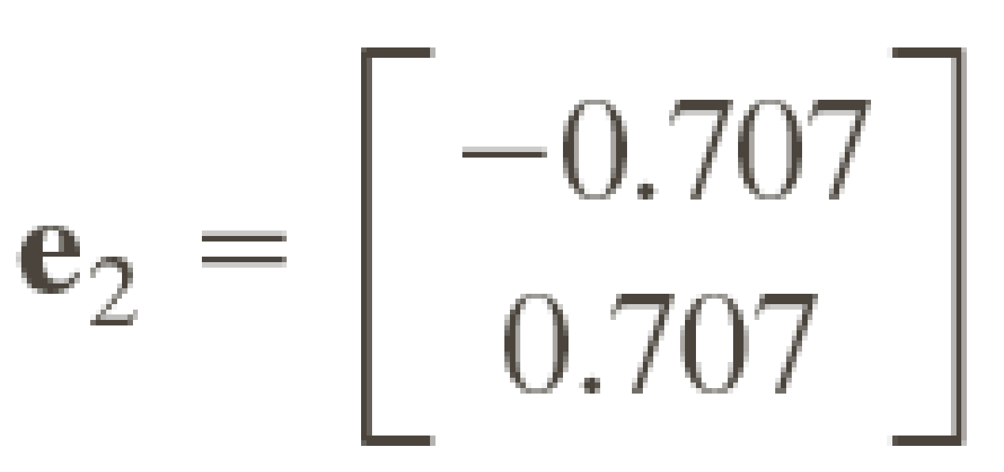
PCA: #1
Nov 2018
‹#›

Slide 45
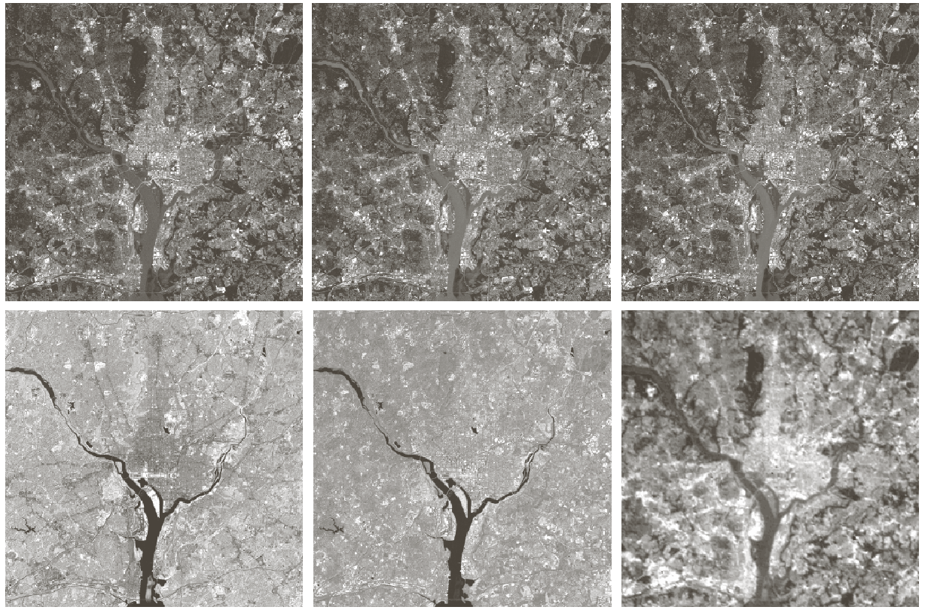
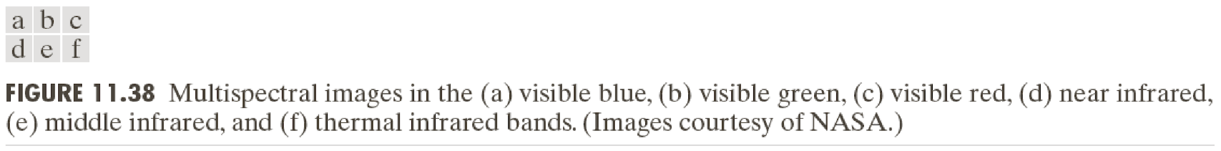


PCA: #2
Nov 2018
‹#›

Slide 46


PCA: #2
Nov 2018
‹#›

Slide 47


PCA: #2
Nov 2018
‹#›

Slide 48


PCA: #2
Nov 2018
‹#›

Slide 49


PCA: #2
6 spectral images
from an airborne
Scanner.
Nov 2018
‹#›

Slide 50

PCA: #2
Component λ
3210.00
931.40
118.50
83.88
64.00
13.40
Nov 2018
‹#›

Slide 51


PCA: #3
Nov 2018
‹#›

Slide 52

PCA: #3
Left: RGB components
Right: First 3 PCs
Nov 2018
‹#›

Slide 53

PCA: #4
Training face images
15 PC eigenfaces
Eigenfaces look like?
Nov 2018
‹#›

Slide 54















PCA: #4
The eigenfaces v₁, ..., v_{K} span the space of faces
A face is converted to eigenface coordinates by
Nov 2018
‹#›

